Slide 1
Advanced Web programming
Lec-11
Web Form Fundamentals

Slide 2
ASP.NET Web server Controls
Server controls are objects placed on a page with the purpose of read and write data.
A Server Control starts with <asp: followed by the object name <asp:textbox .
They must contain two other properties, ID which must be unique and runat=”server” which tells the web server to give the control server side processing.
<asp:control_name id="some_id" runat="server" />
They can be self closed by having a forward slash (/) before the ending tag or have a closing tag:
<asp:textbox id=”txt” runat=”server” />
<asp:textbox id=”txt” runat=”server” ></asp:textbox>
After a control is processed by the web server, a standard HTML tag is sent to the browser for displaying. The above example will be rendered as:
<input type=”text” name=”txt” id=”txt” />

Slide 3
1. Button <asp:button/>
Post back control for form submission.
Example: <asp:button id=”btn” runat=”server” text=”Search”/>
Properties:
2. Checkbox <asp:checkbox/>
Selection control (multiple selections).
Example: <asp:checkbox id=”ck” runat=”server” text=”Diploma”/>
Properties:
Id=”btn” Runat=”server” Text=”Search” Enabled=”true/false” | Creates an unique identifier Sets the button for server side processing Displays text on the button Enables or Disables the button
Id=”ck” Runat=”server” Text=”Diploma” Checked=”true/false” | Creates an unique identifier Sets the checkbox for server side processing Displays text on checkbox Checks or Uncheck the checkbox

Slide 4
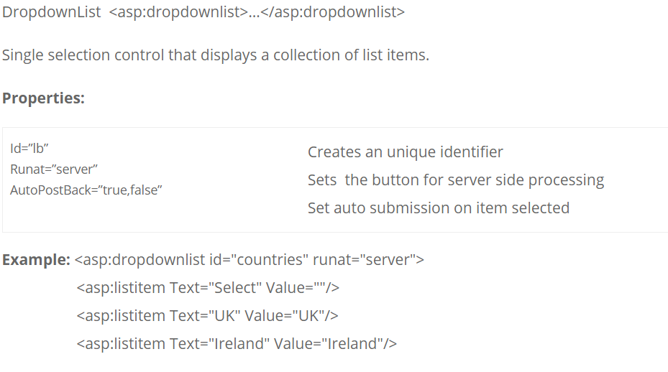
DropdownList <asp:dropdownlist>…</asp:dropdownlist>

Slide 5
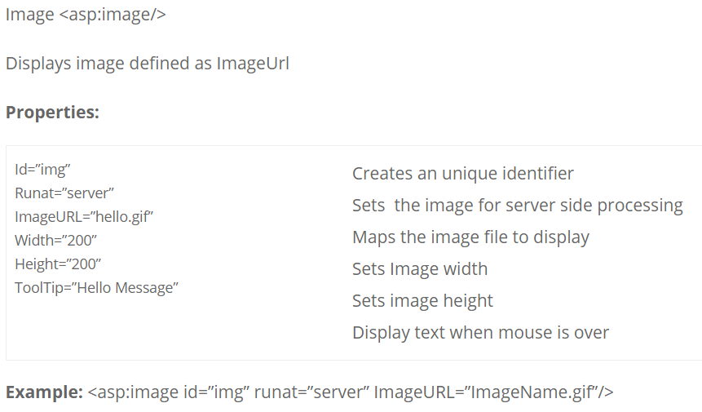

Slide 6
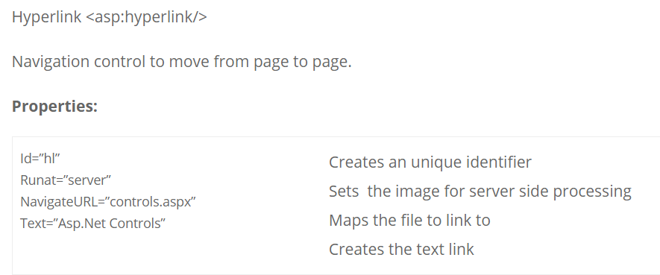
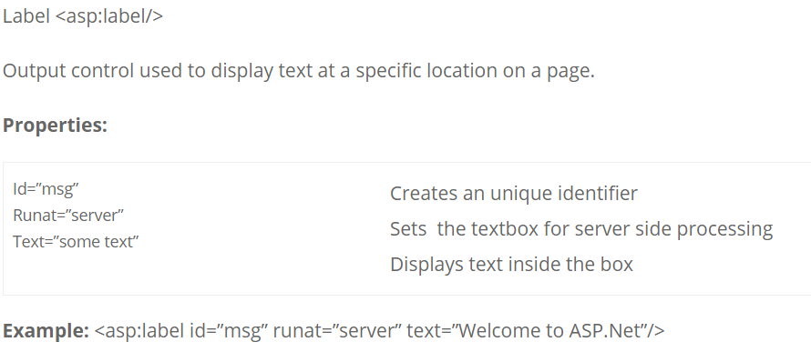

Slide 7
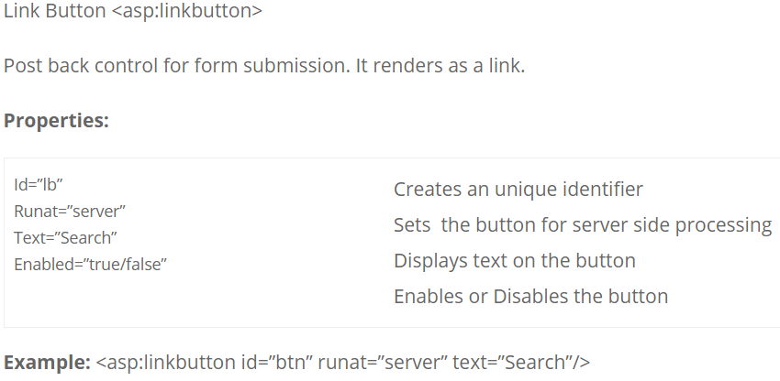

Slide 8
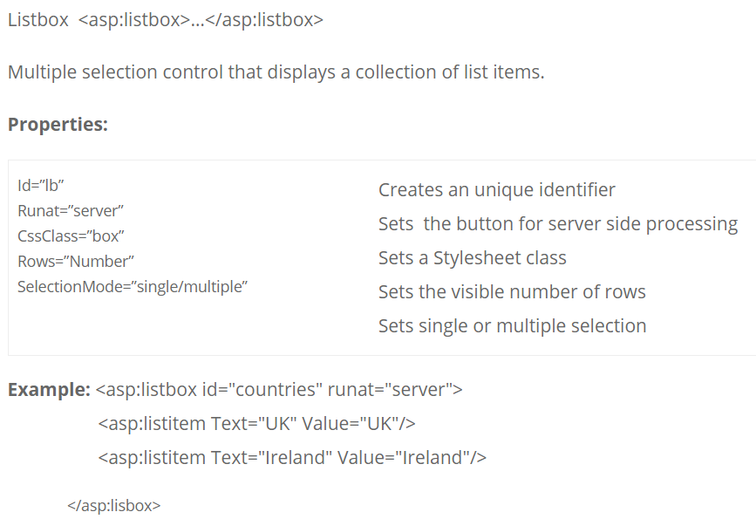

Slide 9
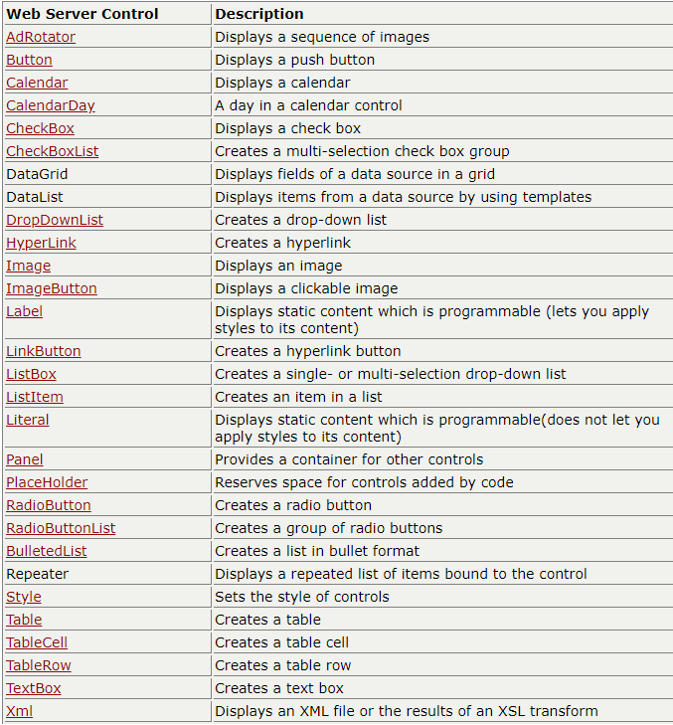

Slide 10
HTML Server Controls
HTML elements in ASP.NET files are, by default, treated as text.
To make these elements programmable, add a runat="server" attribute to the HTML element. This attribute indicates that the element should be treated as a server control.
All HTML server controls must be within a <form> tag with the runat="server" attribute!

Slide 11
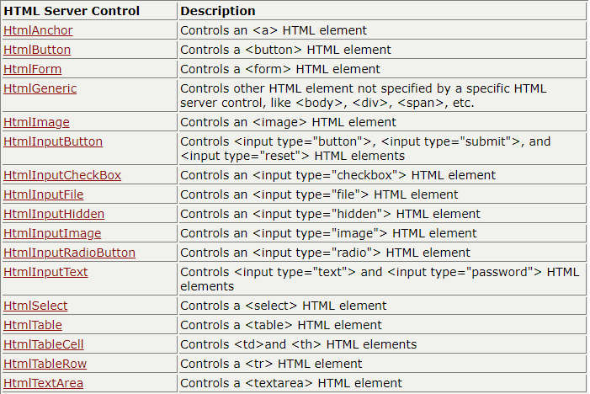

Slide 12
ASP.NET - Event Handling
An event is an action or occurrence such as a mouse click, a key press, mouse movements, or any system-generated notification.
A process communicates through events. For example, interrupts are system-generated events. When events occur, the application should be able to respond to it and manage it.
Events in ASP.NET raised at the client machine, and handled at the server machine.
For example, a user clicks a button displayed in the browser. A Click event is raised. The browser handles this client-side event by posting it to the server.
The server has a subroutine describing what to do when the event is raised; it is called the event-handler.
Therefore, when the event message is transmitted to the server, it checks whether the Click event has an associated event handler.
If it has, the event handler is executed.

Slide 13
Event Arguments
ASP.NET event handlers generally take two parameters and return void. The first parameter represents the object raising the event and the second parameter is event argument.
The general syntax of an event is:
private void EventName (object sender, EventArgs e);
Application and Session Events
The most important application events are:
Application_Start - It is raised when the application/website is started.
Application_End - It is raised when the application/website is stopped.
Similarly, the most used Session events are:
Session_Start - It is raised when a user first requests a page from the application.
Session_End - It is raised when the session ends.

Slide 14
Page and Control Events
Common page and control events are:
DataBinding - It is raised when a control binds to a data source.
Disposed - It is raised when the page or the control is released.
Error - It is a page event, occurs when an unhandled exception is thrown.
Init - It is raised when the page or the control is initialized.
Load - It is raised when the page or a control is loaded.
PreRender - It is raised when the page or the control is to be rendered.
Unload - It is raised when the page or control is unloaded from memory.

Slide 15
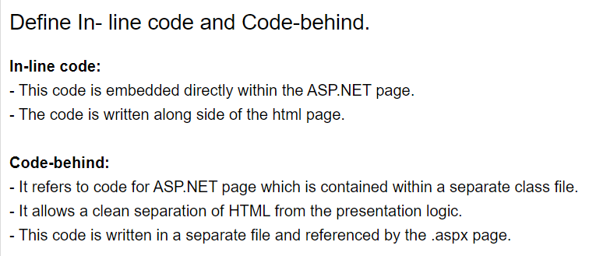

Slide 16
Event handling in ASP.NET
The events are raised by the client. The server handles all the event requests.
If the user presses a key, the keypress event is raised. The server handles the keypress event.
The event handler is a subroutine defined at the server end. The actions to be performed when an event is raised are defined in the handler.
Once the event is raised by the client, the server checks for the availability of the appropriate handler.
If the corresponding event is present, the event handler is executed.

Slide 17
ASP.NET provides important feature event handling to Web Forms. It let us to implement event-based model for our application.
As a simple example, we can add a button to an ASP.NET Web Forms page and then write an event handler for the button's click event. ASP.NET Web Forms allows events on both client and server sides.
In ASP.NET Web Forms pages, however, events associated with server controls originate on the client but are handled on the Web server by the ASP.NET.
ASP.NET Web Forms follow a standard .NET Framework pattern for event-handler methods.
All events pass two arguments: an object representing the object that raised the event, and an event object containing any event-specific information.

Slide 18
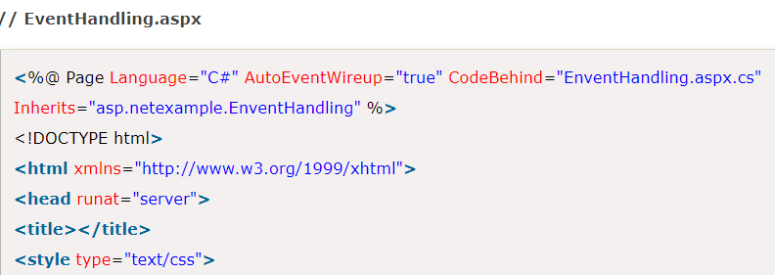
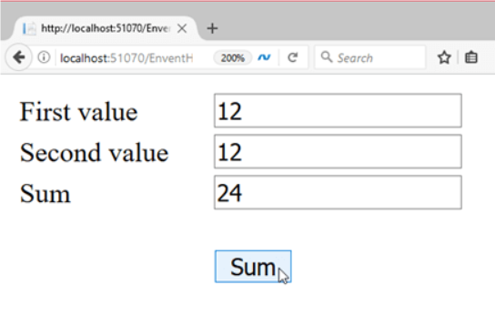
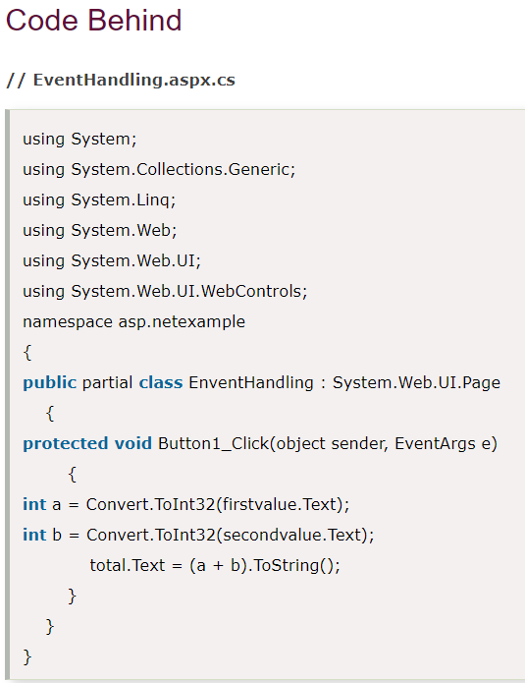
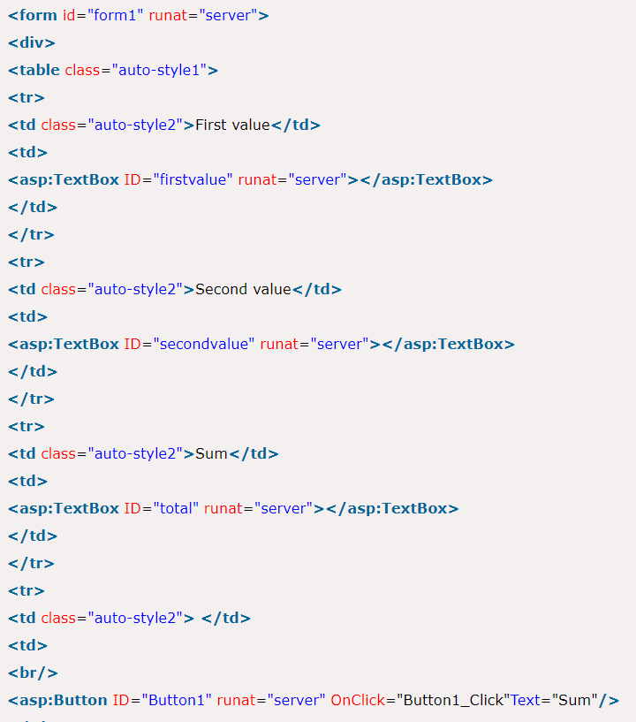
Here, we are creating an event handler for click event. In this example, when user click on the button, an event fires and handler code executes at server side.

Slide 19
The Response.Redirect method redirects a request to a new URL and specifies the new URL while the Server.Transfer method for the current request, terminates execution of the current page and starts execution of a new page using the specified URL path of the page. Both Response.Redirect and Server.Transfer has the same syntax like:
Response.Redirect("UserDetail.aspx");
Server.Transfer("UserDetail.aspx");
To use Server.Transfer() when you want to navigate pages which reside on the same server, use Response.Redirect() when you want to navigate between pages which resides on different server and domain.

Slide 20
Validation Controls in ASP.NET
An important aspect of creating ASP.NET Web pages for user input is to be able to check that the information users enter is valid. ASP.NET provides a set of validation controls that provide an easy-to-use but powerful way to check for errors and, if necessary, display messages to the user.
There are six types of validation controls in ASP.NET
RequiredFieldValidation Control
CompareValidator Control
RangeValidator Control
RegularExpressionValidator Control
CustomValidator Control
ValidationSummary

Slide 21
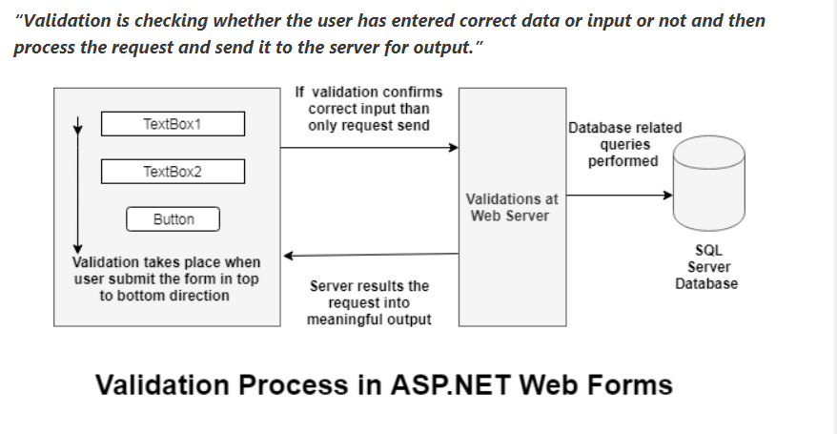

Slide 22
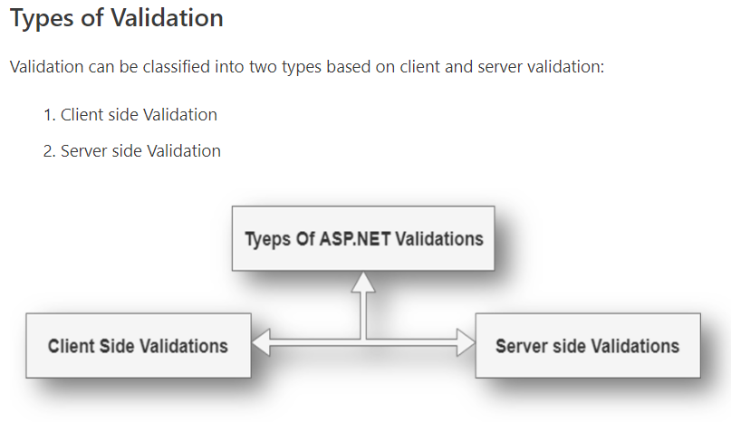
Validation can be performed at the client-side as well as server-side.
Client-side validation makes the process fast as there is less number of hits to the server.
Server-side validation is used to remove the limitation of client browsers dependencies and scripting language support.

Slide 23
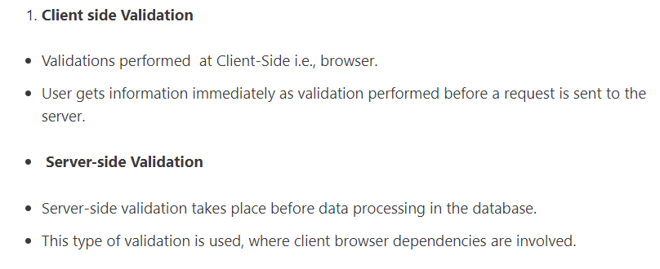

Slide 24
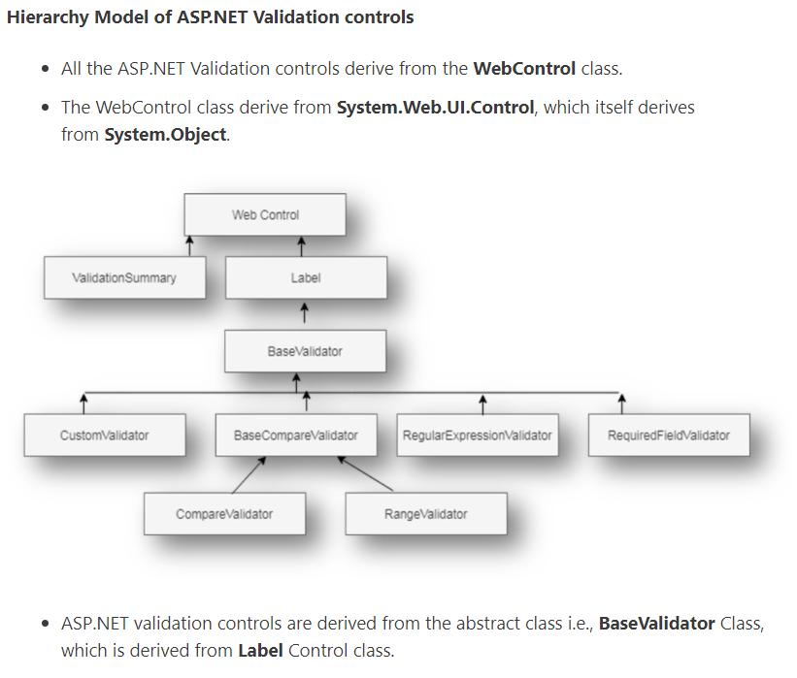

Slide 25
BaseValidator Class
BaseValidator class is parent for all ASP.NET validation controls.
It is abstract class means we cannot directly instantiate BaseValidator.
All ASP.NET Validation controls inherit methods and properties of BaseValidator class.

Slide 26
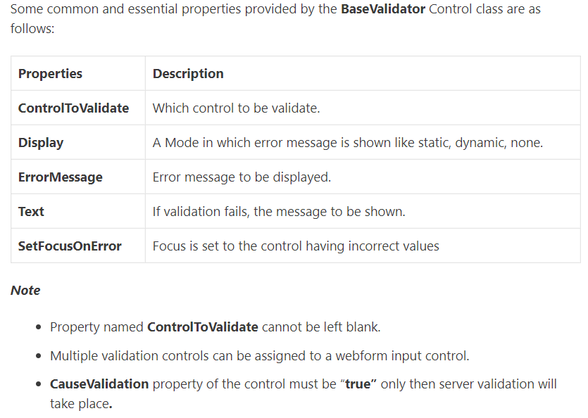

Slide 27
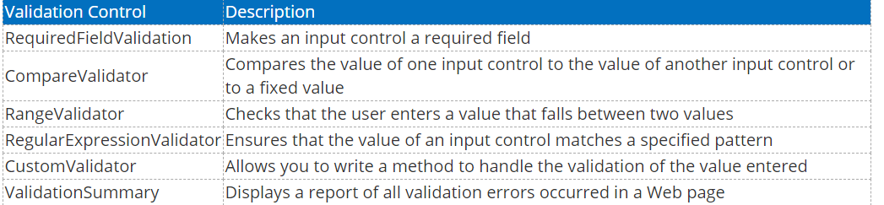

Slide 28
ASP.NET - Custom Controls & User Controls
ASP.NET allows the users to create controls. These user defined controls are categorized into:
User controls
Custom controls
User Controls
User controls behaves like miniature ASP.NET pages or web forms, which could be used by many other pages. These are derived from the System.Web.UI.UserControl class. These controls have the following characteristics:
They have an .ascx extension.
They may not contain any <html>, <body>, or <form> tags.
They have a Control directive instead of a Page directive.

Slide 29
ASP.NET - Custom Controls & User Controls
ASP.NET allows the users to create controls. These user defined controls are categorized into:
User controls
Custom controls
User Controls
User controls behaves like miniature ASP.NET pages or web forms, which could be used by many other pages. These are derived from the System.Web.UI.UserControl class. These controls have the following characteristics:
They have an .ascx extension.
They may not contain any <html>, <body>, or <form> tags.
They have a Control directive instead of a Page directive.

Slide 30
List Controls in ASP.NET
ASP.NET provides the following list controls.
1. Drop-down list
2. List box
3. Radio button list
4. Check box list
5. Bulleted list
These controls display list of options to select. You can select one or more options, the choice depends upon control.
They all derive from the System.Web.UI.WebControls.ListControl class.

Slide 31
Some of the important common properties of list controls are as follows:
SelectedValue: Get the value of the selected item from the dropdown list.
SelectedIndex: Gets the index of the selected item from the dropdown box.
SelectedItem: Gets the text of selected item from the list.
Items: Gets the collection of items from the dropdown list.
DataTextField: Name of the data source field to supply the text of the items. Generally this field came from the datasource.
DataValueField: Name of the data source field to supply the value of the items. This is not visible field to list controls, but you can use it in the code.
DataSourceID: ID of the datasource control to provide data.

Slide 32
There are several ways through which you can populate these controls such as:
By using data from database.
Directly write code to add items.
Add items through the items collection from property window.
Write HTML to populate these controls.
Use inbuilt datasource controls.

Slide 33
1. DropDownList control
DropDownList control is used select single option from multiple listed items.
Select the item from the DropDownList, the label control will display the selected item.
Write code with association with IsPostBack property, otherwise will get the first item of the DropDownList.

Slide 34
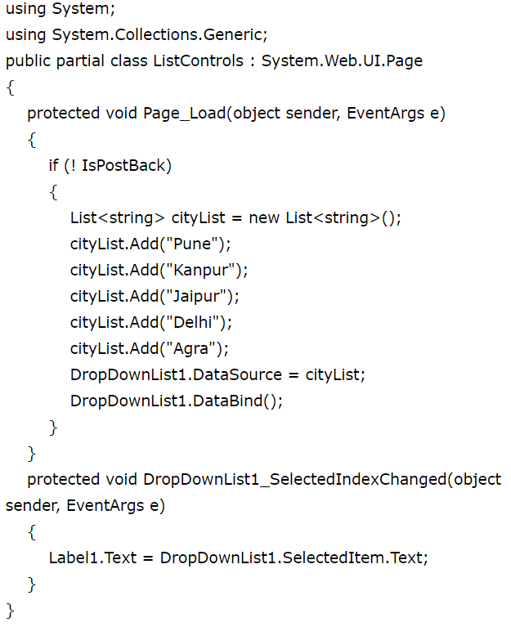

Slide 35
2. ListBox control
The ListBox control is similar to the DropDownList but main difference is that you can select multiple items from ListBox at a time.
ListBox control has SelectionMode property that enables you to select multiple items from ListBox control.
By default SelectionMode property is set as single.
If you want to select multiple items from the ListBox, then set SelectionMode property value as Multiple and press Ctrl or Shift key when clicking more than one list item.
The ListBox control also supports data binding.
You can bind the ListBox through coding with database or attach it with one of the predefined DataSourceControl objects, which contains the items to display in the control.
DataTextField and DataValueField properties are used to bind to the Text and Value field in the data source.
The Add method adds new items at the end of an unsorted list box. The Insert method allows you to specify where to insert the item you are adding.

Slide 36
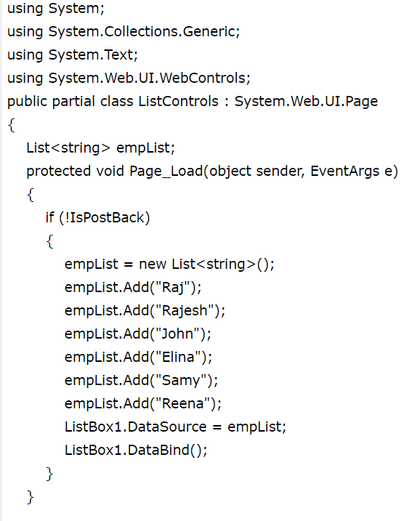
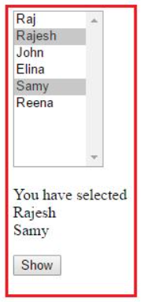
Click on show button, you will get the selected items.
The ListBox control has a SelectedIndexChanged event handler.
If AutoPostBack property is set to true, then this event is raised whenever you select new item from the List control.

Slide 37
3. RadioButtonList Control
RadioButtonList Control is same as DropDownList but it displays a list of radio buttons that can be arranged either horizontally or vertically.
You can select only one item from the given RadioButtonList of options.
The RadioButtonList control supports three important properties that affect its layout: RepeatColumns: It displays the number of columns of radio buttons. RepeatDirection: The direction that the radio buttons repeat. By default RepeatDirection value is vertical. Possible values are Horizontal and Vertical. RepeatLayout: Determines whether the radio buttons display in an HTML table.
Possible values are as follows: Table
Flow
OrderedList
UnorderedList

Slide 38
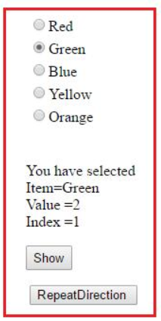


You can add items in RadioButtonList through item collection using property window.
When you click on the RepeatDirection button the layout will be changed as Horizontal.
RadioButtonList1.RepeatDirection = RepeatDirection.Horizontal;
By default RepeatColumns value is zero. You can change this value according to
application need.
If you set this value as three then output will be changed as:

Slide 39
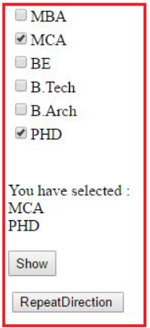

4. CheckBoxList Control
CheckBoxList is generally used, when you want to select one or more options from given several choices.
Most of the properties are same as RadioButtonList control, but the main difference is that you can select more than one item from CheckBoxList control.
The CheckBoxList control is easier for use, when you have set of options of checkboxes.
When you click on the RepeatDirection button the layout will be changed as Horizontal.
By default, RepeatDirection is set to RepeatDirection.Vertical.

Slide 40
5. BulletedList Control
BulletedList control is very rich in displaying the items in different styles.
It dispalys the list either in unordered or ordered list. Each list item can be rendered as plain text, a LinkButton control, or a link to another web page.
BulletedList control supports the BulletStyle property.
The default value of BulletStyle property is NotSet and rendered as in list of bulleted items.
BulletedList control also supports the DisplayMode property that is used to modify the appearance of list items.
Possible values are as follows:
HyperLink
LinkButton
Text

Slide 41
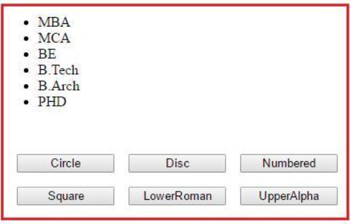
When you click on different button, the button style of list control will be changed accordingly.
In this example we have used Command Button concept.

Slide 42
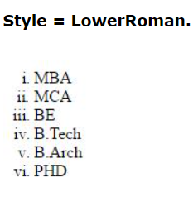
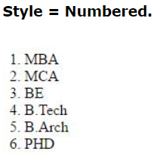
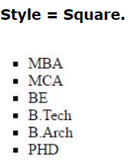

Slide 43
To be continued….

